Slide 1
Location Based Restaurants Recommendation System Spring 2017
Team Members:
Lopamudra Muduli(lxm160730)
Shruti Harihar (sxh164530)
Bhakti Khatri (brk160030)
Ankita Patil (asp160730)
Nikhil Kumar Chandra (nxc161330)

Slide 2
PROJECT DEFINITION
We are developing static and streaming recommendation system for the recommendation of the restaurants.
Both the recommendation systems are built using Yelp academic datasets.
Both static and streaming recommendation systems are User Input Driven.
The trending top rated location specific restaurants information is provided by streaming recommendation systems .

Slide 3
MOTIVATION
Reviews and rating play a key role for users in decision making.
People are sharing their experiences on products or services in the form of reviews, which enables other users for their decision making.
It is hard for the user to go through each review, and it might mislead the user to use a wrong service or a product, if he/she goes by the review given by a user with opposite taste.
Therefore, we came up with a system which recommends the user depending on his needs.

Slide 4
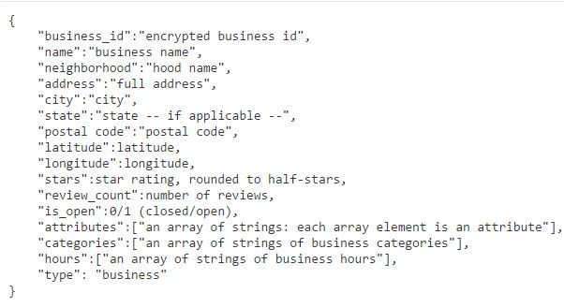
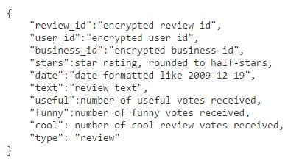
DATASET
Business
Review

Slide 5
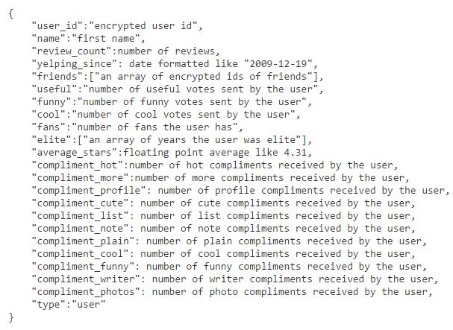
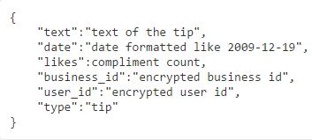
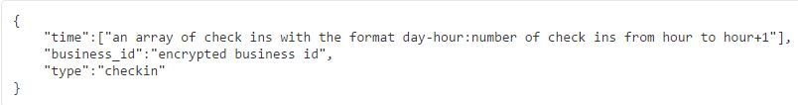
DATASET
User
Tip
Check-in

Slide 6
SIZE OF DATA
 | Rows | Size | Description
Businesses | 229,222 | 32MB | Info of businesses
User | 686,557 | 159MB | Users
Reviews | 9,275,055 | 1.8GB | By users
Check-In | 61,050 | 14MB | Timings
Tip | 667,238 | 79MB | Derived from reviews

Slide 7
TECHNICAL APPROACH
The Static Recommendation system is built on Apache Spark with Scala.
We are using ALS for Collaborative filtering for static data recommendation system.
The streaming recommendation system is based on the ratings and user’s current location.

Slide 8
STATIC RECOMMENDATION SYSTEM
Recommends top 5 restaurants in a city to the user based on the type of food, city and state entered by user
Input: City, State, Category of food
Static recommendation system is rating driven as reviews/ratings play a key role for choosing the best service or product
Technical Details :
The system is built on Apache Spark with Scala
JAVA JDK 1.8
Spark version = 2.1.0
Scala version = 2.11.8

Slide 9
Working:
Take the input from the user,
Input: City, State, Category of food
Based on the input, filter the business data file
Find out the relevant restaurants based on the input by user, let’s call them Target Restaurants
Now, get the data from review file which contains the ratings or reviews given to the restaurants.
Join Target Restaurants with reviews
Build an ALS Matrix comprising of users who have reviewed the target restaurants. This data is is used as a training data
Test data: current user, list of restaurants
Test and predict ratings in the required food category for the current user
Return top 5 restaurants based on the average rating

Slide 10
User Input
Relevant
Businesses
Businesses
Filter by
Category of Food,
City and State
Reviews
Join with business ID
Top 5 Rated restaurants
Building an
ALS Matrix
from the Reviews
Filter by
Recent Reviews

Slide 11
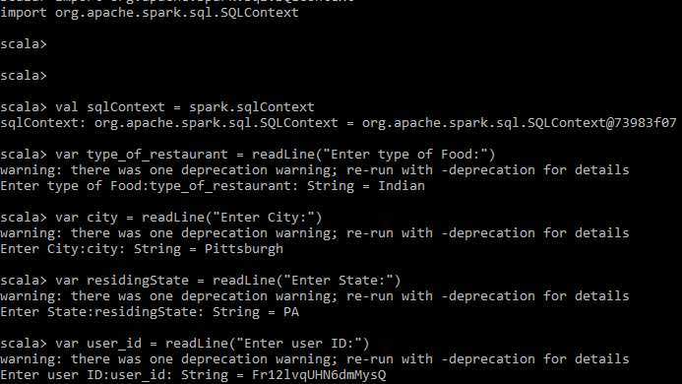
EXPERIMENTS AND RESULTS (Static Part)

Slide 12
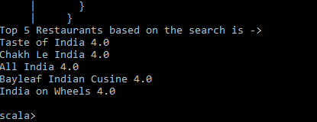
EXPERIMENTS AND RESULTS (Static Part)

Slide 13
STREAMING RECOMMENDATION SYSTEM
Recommends top 5 TRENDING restaurants in a city(Las Vegas) to the user based on user location and the type of food entered by user.
Input: Category of food and location
Streaming recommendation system is based on the current ratings of the restaurants so that we can get the updated recent information about the food quality. So we are judging the restaurants based on its current performance not its previous rating, which is helpful for both user and business providers.
Technical Details :
The system is built on Apache Spark with Scala
Python = 2.7
Spark version = 2.1.0
Scala version = 2.11.8
Elasticsearch
Kibana

Slide 14
STREAMING RECOMMENDATION SYSTEM Overview
Filter the Business Data for city, star, Business_id, categories, name, stars, state, full_address, latitude and longitude.
Filter the Tip data for business_id and text.
Scala program is used for the joining of the filtered data from Business Data and Tip Data. The output from this is a csv File (having information for both Businesses with Tip data files)
Sending the merged data to kafka consumer to simulate the streaming process using PySpark program.

Slide 15
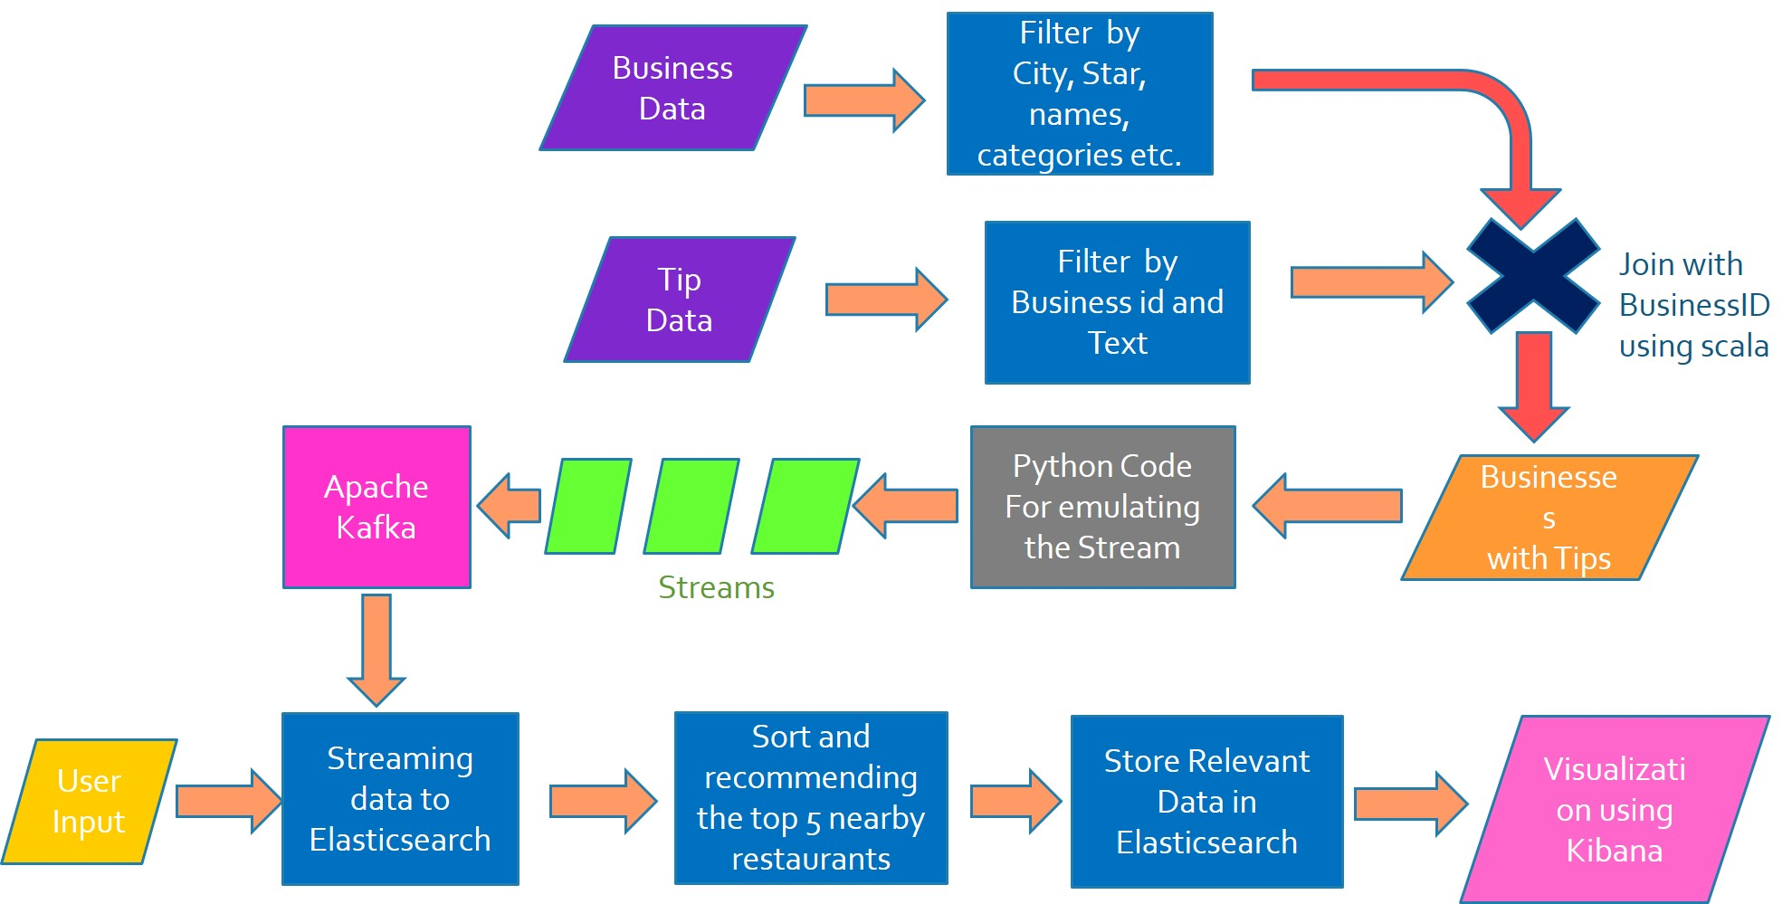

Slide 16
Working Functionality:
Filter the Business Data (for city, star, Business_id, categories, name, stars, state, full_address, latitude and longitude) and Tips Dataset (for Business_id and Text).
Join the Business Data with Tip Data and write the output to a csv File
Read this output file by kafka producer written in python.
This Program acts as a Producer and we are simulating the Streaming Process
The Data is sent to the kafka consumer and thereby processed with PySpark.
Later the data is sent to Elasticsearch
Using this data we can visualize using Kibana

Slide 17
STREAMING ANALYSIS
Now at the spark side we have rows of (city,star,Business_id,categories,name,stars,state,full_address,latitude,longitude)
We are collecting the (business_id, text) and appending all the text info (reduceByKey) for a business_id.
Based on User Input which is usually a category, we match it with the streaming data and then cluster all the restaurants that are in a radius of 5 miles. Further, we sort top 5 restaurants based on the user input and its corresponding ratings.
The elasticsearch stores the streaming data information and this stored data is processed further to get the trending rating information about the restaurants.
Suppose the user searches for “Burger”, match Burger with the category of the streaming data and then filter the restaurants that are in a 5 miles radius. Then return top 5 restaurants based on the average ratings from the streaming data information.
Finally send the required information to store in elasticsearch and visualize the location using Kibana.

Slide 18
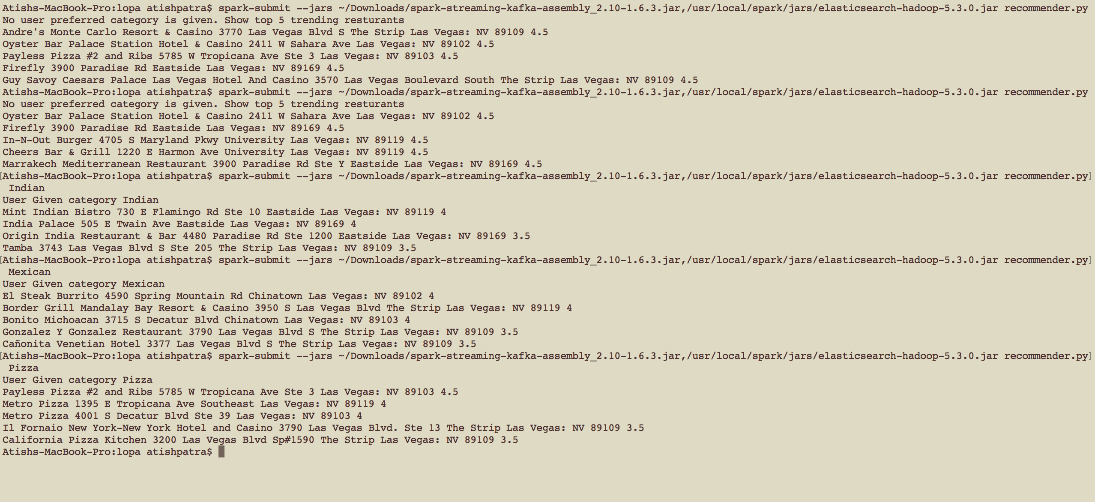

Slide 19
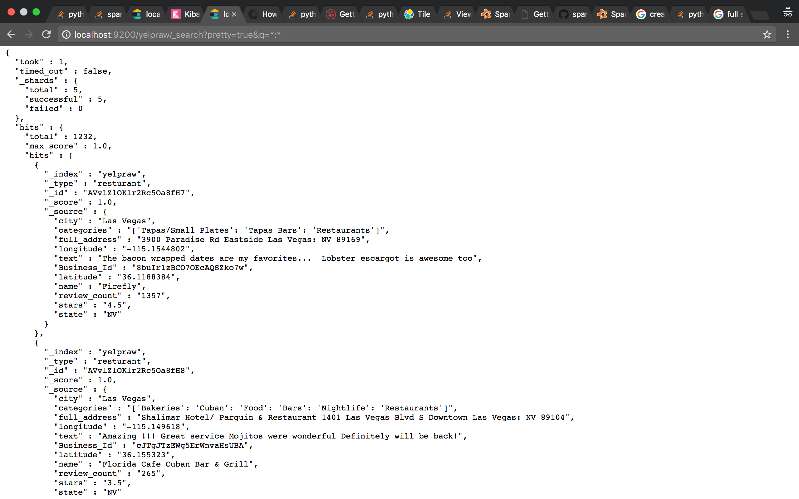

Slide 20
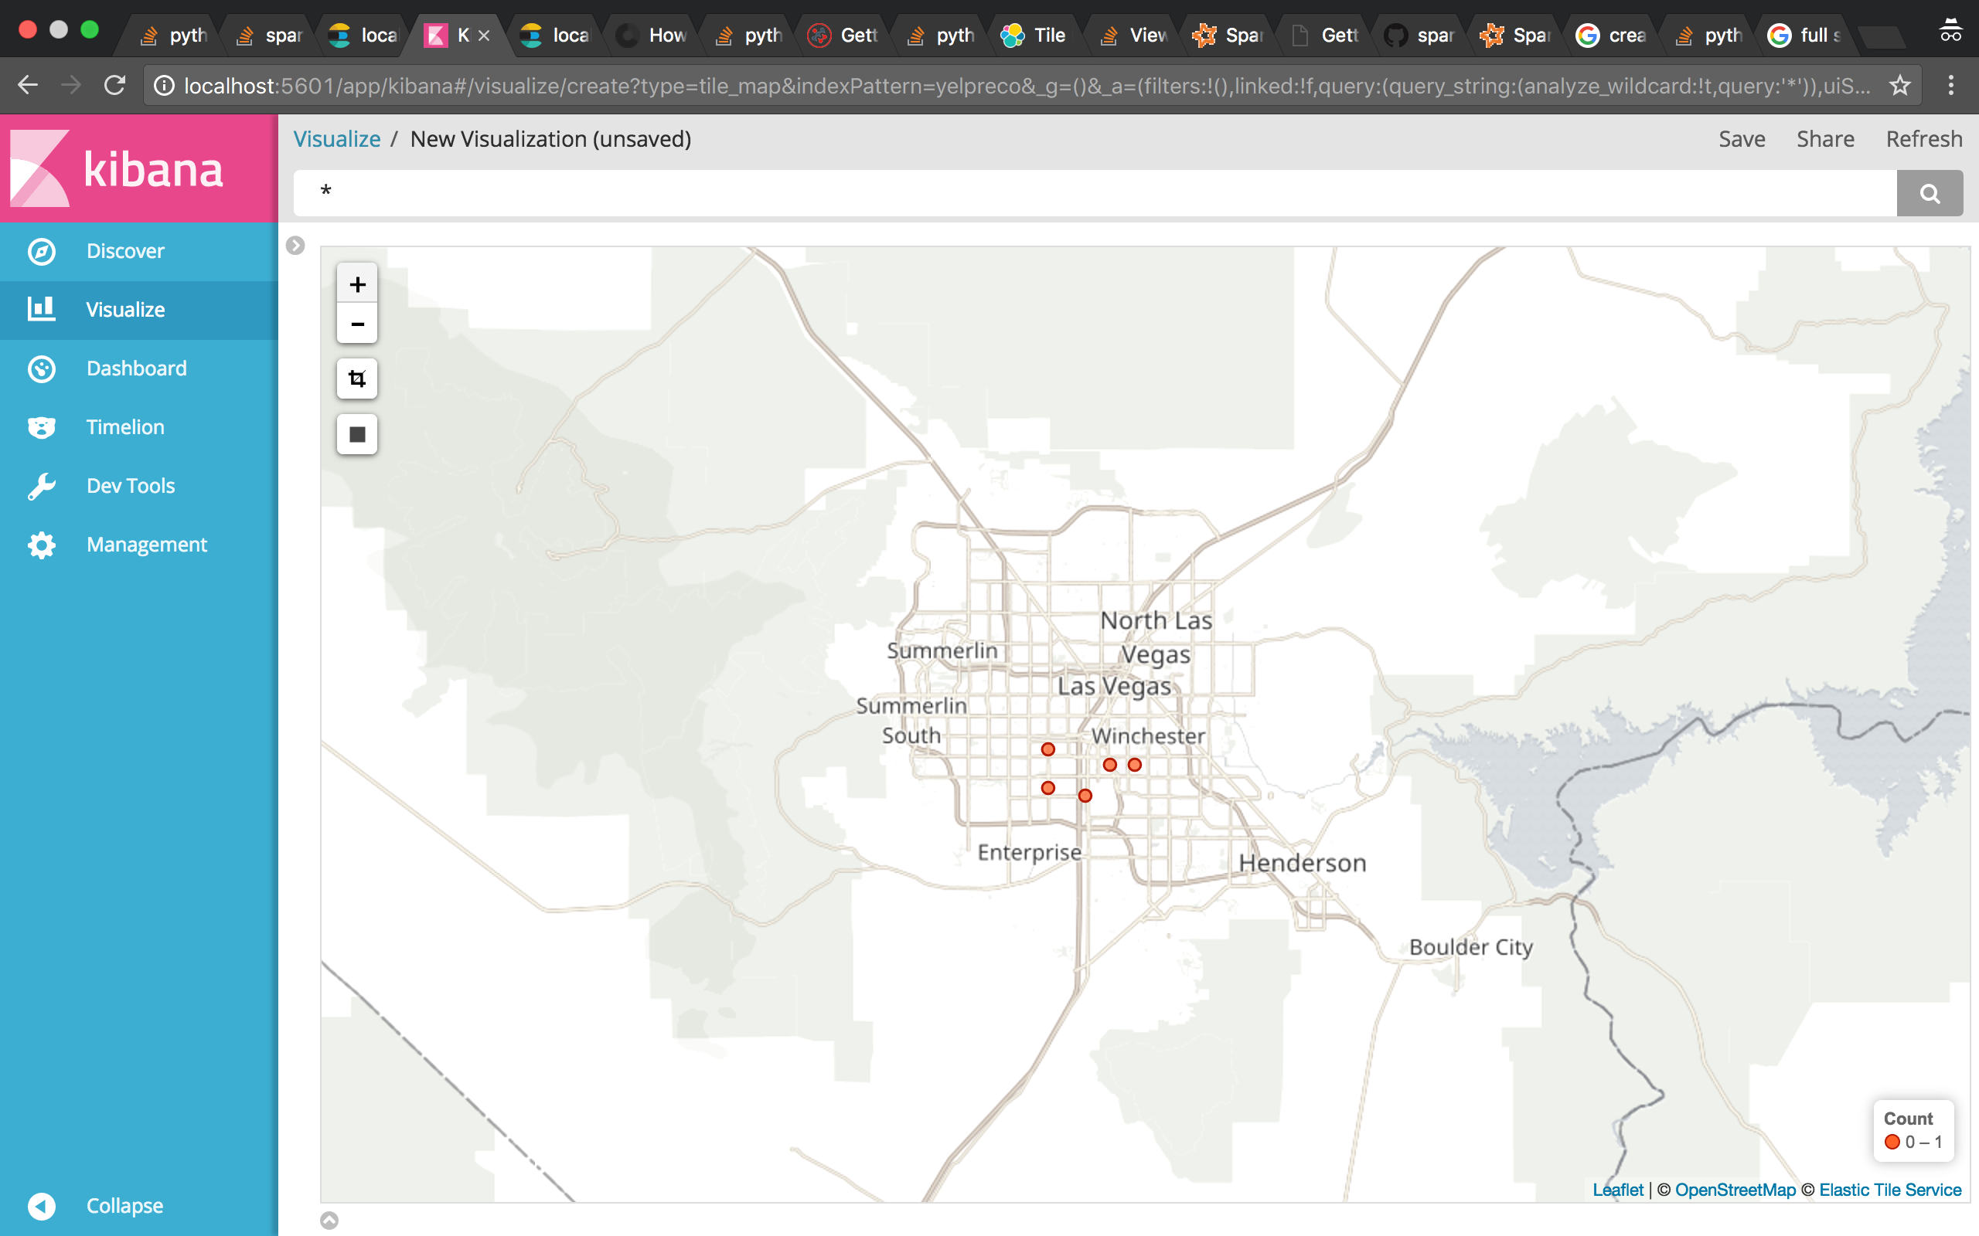

Slide 21
TECHNOLOGIES USED
PySpark with Streaming and MLLib(ALS)
Python (as Kafka Producer/Consumer)
Apache Kafka
Zookeeper
Scala (Removing unnecessary attributes)
Elasticsearch(for storing JSON file)
Kibana (for visualization)

Slide 22
PROBLEMS FACED
Similar Data Conversion→ excellent => good, amazing => good
Merging of dataset was cumbersome due to its size
Streaming Data from a File
Less Data for any location specific
Handling BigData with RDDs (using filter while reading data)

Slide 23
FUTURE SCOPE
We considered only the positive part of the User Review, can use negative as well to do a sentiment Analysis
Restaurant Specific analysis over the time can be done
Business specific check-in can also be analyzed to give user analysis on busy timings

Slide 24
CONCLUSION
Our work proposed a new approach to recommend user better restaurants based on analyzing daily reviews.
This helps the user to choose the better restaurant on the same day.
As discussed in the future work section, if we are able to extend work by implementing sentimental analysis we can acquire much better results.

Slide 25
THANK YOU

